Slide 1
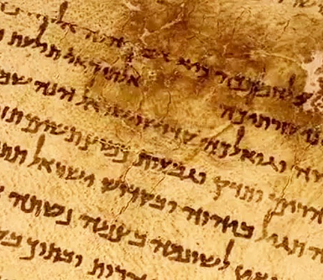
The Reliability of the Scriptures: A Historical and Archeological Survey
Prof. David Sedaca

Slide 2
GENERAL INTRODUCTION
LECTURE 1

Slide 3
BASIC PREMISE
WE BELIEVE in the verbal, plenary inspiration of the Bible, which is, therefore, inerrant and infallible in the original autographs.
(Ps 107:11; 119:160: Mark 7:6-13; John 10:35; 2 Tim. 3:16-17; Heb 1:1-3; 2 Peter 1:20-21)

Slide 4
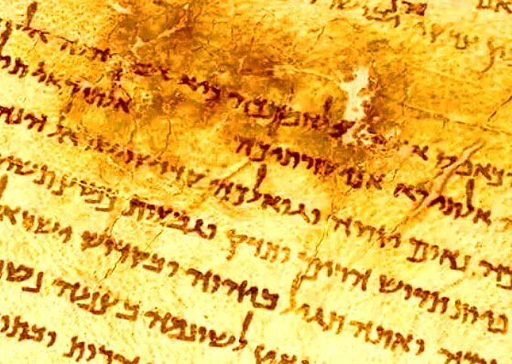
The need for this study
The purpose of this course
This study will be based on the following assumptions:

Slide 5
History is reliable
Archaeology does not prove the veracity of a biblical text or historical event
Archaeological findings are “Circumstantial pieces of evidence”
Selected scope
Diverse audience
Limited to biblical lands and peoples

Slide 6
DEFINITION OF BIBLICAL ARCHAEOLOGY
The science of archaeology (from Greek ἀρχαιολογία, archaiologia from ἀρχαῖος, arkhaios, "ancient" and -λογία, -logia, "-
Archaeology is the study of human activity through the recovery and analysis of material culture. Archaeology is often considered a branch of socio-cultural anthropology, but archaeologists also draw from biological, geological, and environmental systems through their study of the past. The archaeological record consists of artifacts, architecture, biofacts or ecofacts and cultural landscapes
Biblical archaeology focuses on biblical lands and peoples

Slide 7
DIFFERENT APPROACHES TO THE STUDY OF
BIBLICAL ARCHAEOLOGY
Old Testament Archeology studies archaeological sites, historical records, and artifacts
New Testament Archaeology deals primarily with the original writings, transmission, and translation of the texts that form the New Testament canon.

Slide 8
EARLY ARCHAEOLOGISTS
I. Roque Joaquin de Alcubierre (Spanish) 1738 in Herculaneum
II. Mercello di Venuti (Italian) 1748 in Pompeii
Lucas Holstenius and Karl Jakob Weber (Germans) supervised
the excavations using scientific methods from 1750 to 1765
The British established the Society for Antiquities in 1753,
followed by the British Museum in 1753-1759
In 1793 the Louvre Museum was founded in Paris
Political motivations

Slide 9
PIVOTAL MOMENTS IN ARCHAEOLOGY

Slide 10
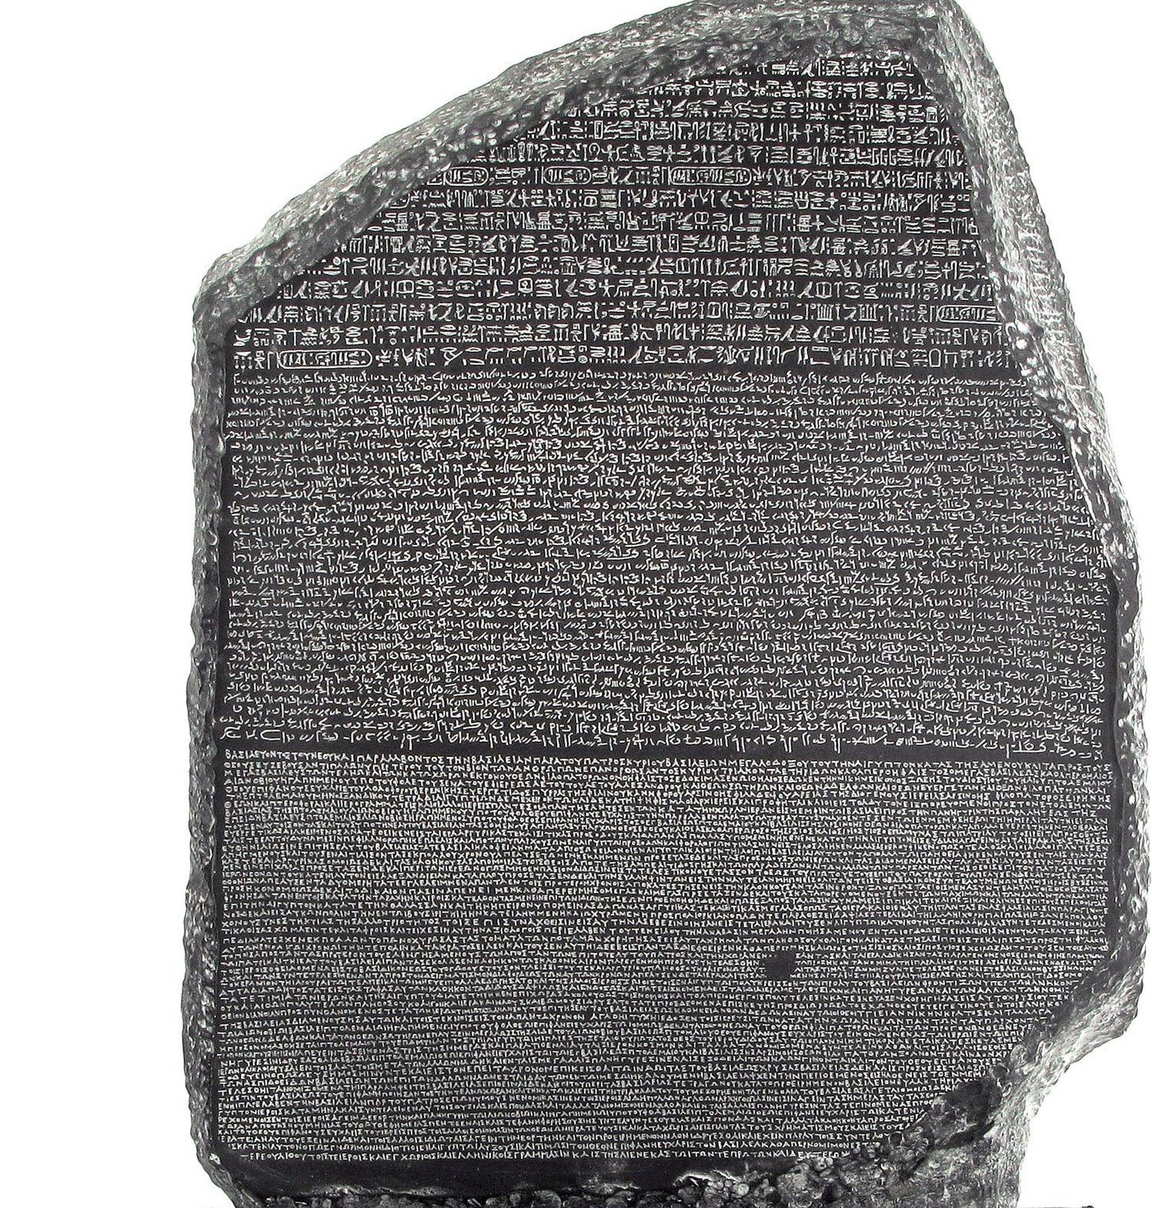
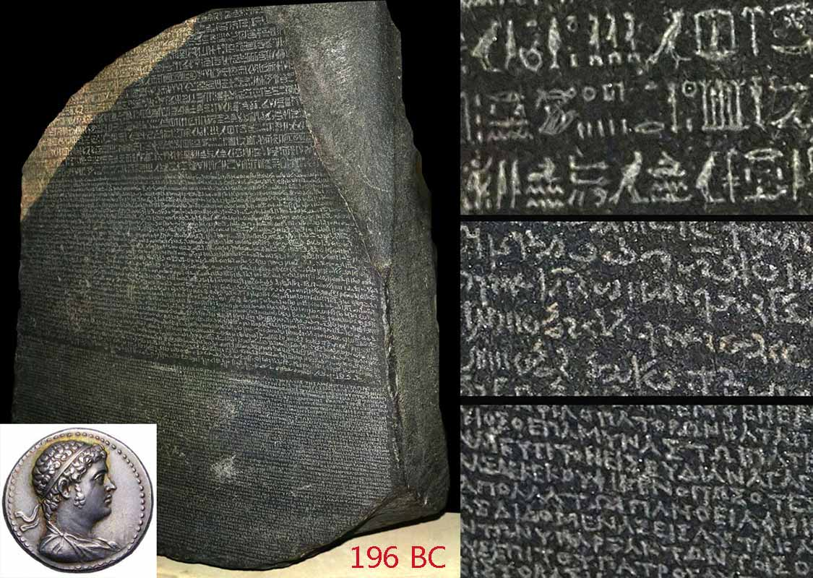
The Rosetta Stone
1892-1893

Slide 11
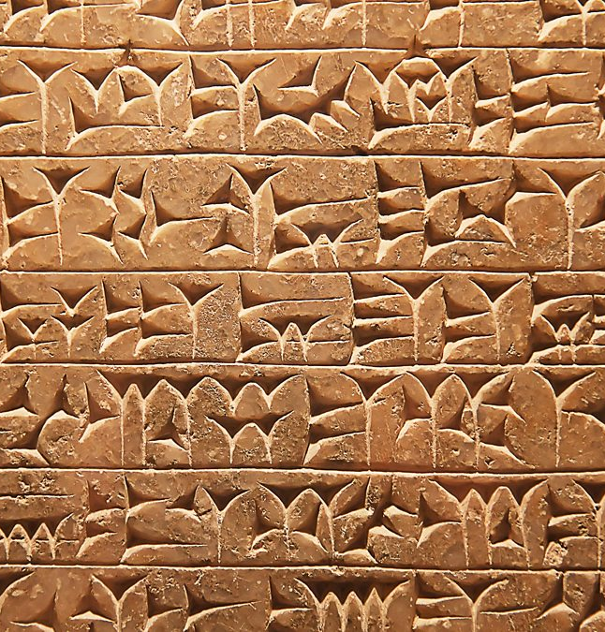
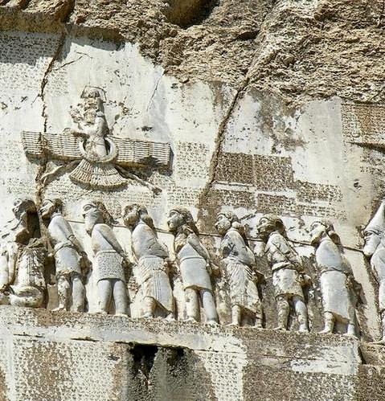
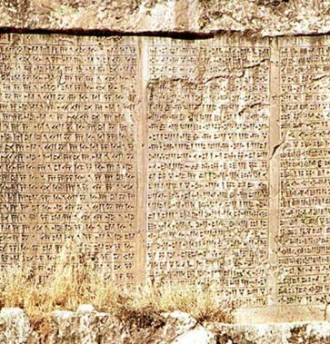
The Behistun Inscription
DECIPHERING 3 DIFFERENT CUNEIFORM SCRIPTS:
OLD PERSIAN, ELAMITE, AND AKKADIAN
1842

Slide 12
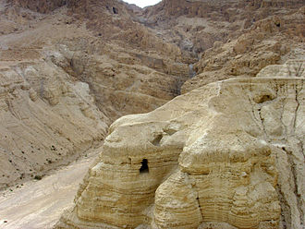
The Dead Sea Scrolls 1946-1947

Slide 13
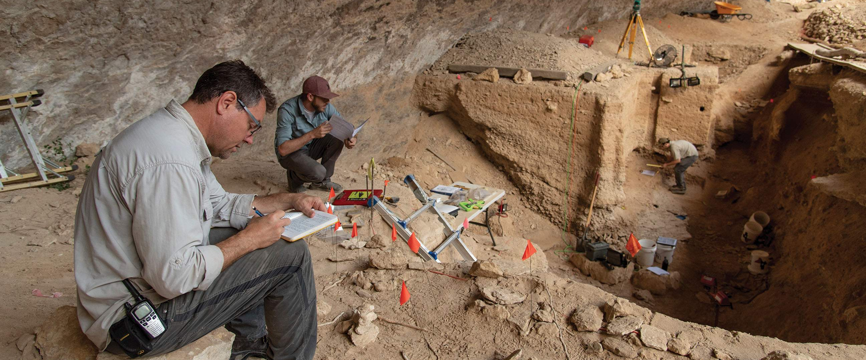
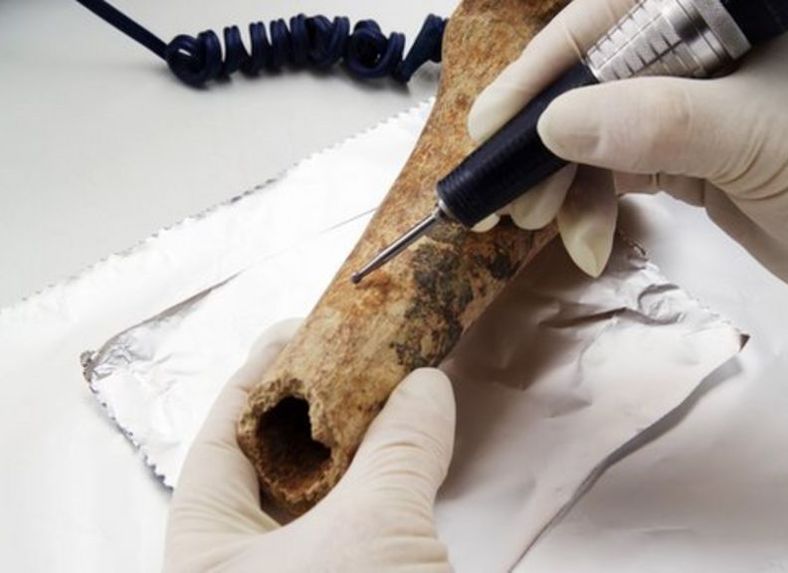
MODERN METHODS OF ARCHAEOLOGICAL RESEARCH

Slide 14
Founding of the State of Israel
in 1948

Slide 15
LIMITATIONS OF ARCHAEOLOGY
I. Oldest does not make true
II. Archaeologists may reach the wrong conclusions
Biblical archaeology is a new science; much remains
to be done
Fragmentary nature of the evidence
i. Existence
ii. Surveyed
iii. Excavated
iv. Examined
v. Published

Slide 16
We see only incomplete data
We all have presuppositions
Oldest does not make true
Preconceived ideas
Subjective and objective interpretations
Minimalist and Maximalist approaches

Slide 17
COMMON MISCONCEPTIONS
See more than what the evidence shows
Archaeology is an exact science
Old science is bad science
The simple answer is the best answer
The fallacy of "negative proof“
There is no neutrality

